Slide 1

1st Year Careers Guidance
2017 2018
Lesson 1 My Career Interests
Lesson 2 CAT4 Feedback
Lesson 3 Junior Cycle Subject Choices in PCA

Slide 2
Lesson 1
My Career Interests
learn about our career interests
learn about what people with these interests like to do
identify possible careers for the future

Slide 3

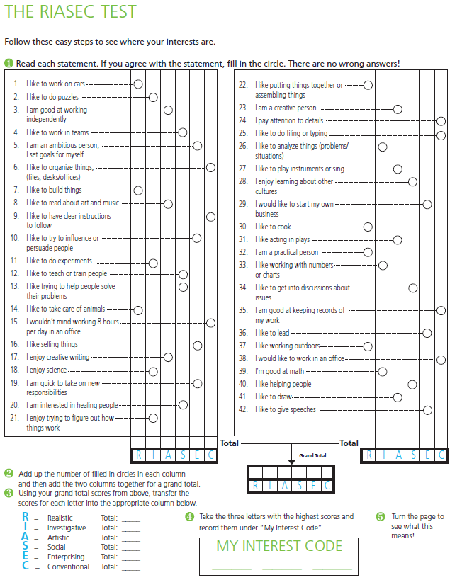
Date Careers Mr. Courtney
Lesson 1: My Career Interests

Slide 4
My Career Interests
My Score
R – Realistic likes working with hands / body /outside /doing / making _____
I – Investigative likes asking questions and solving problems _____
A – Artistic likes to be creative / designing / making _____
S – Social likes working with people (helping / caring / showing) _____
E – Enterprising likes persuading others / performing _____
C – conventional likes to be organised and have clear instructions _____
My Interest Code ____ ____ ____

Slide 5
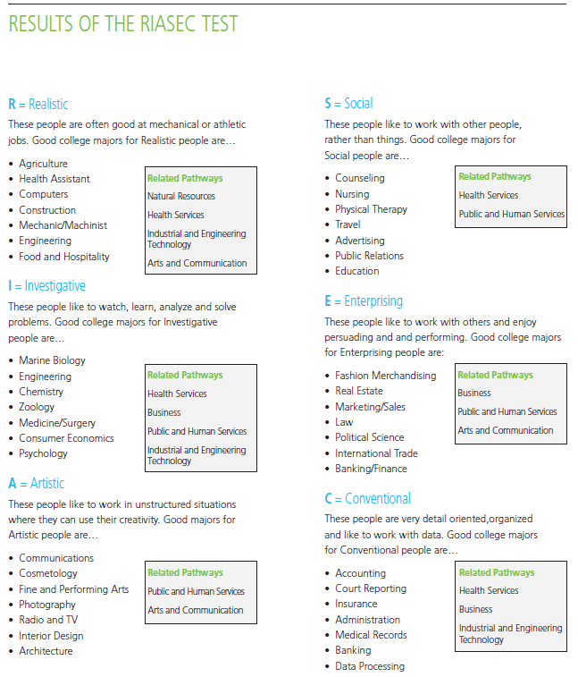
Read through your codes.
Look to see what people
With these interests like
To do.
Circle careers that you
might like to think about
In the future.

Slide 6
Reflect and share.
I learned that my career interests are ___, ___ and ___.
People with these interests like to _____, _______ and ____.
Careers that might be of interest to me include
_______ _________ _________

Slide 7
1st Year Careers Guidance
2017 2018
Lesson 1 My Career Interests
Lesson 2 CAT4 Feedback
Lesson 3 Junior Cycle Subject Choices in PCA

Slide 8
Lesson 2
CAT4 Feedback
what is the CAT4 and what’s assessed
type of results CAT4 gives us
how we can use these results in choosing subjects

Slide 9
Date Careers Mr. Courtney
Lesson 2: CAT4 Feedback

Slide 10
Lesson 2: CAT4 Feedback
Remember this……
New
Old
Wet
A Rain
B Drip
C Hot
D Sun
E Dry
You are using Verbal Reasoning

Slide 11
Lesson 2: CAT4 Feedback
And this…
The piece of paper is folded and a hole is punched in it.
Which answer represents the unfolded paper?
You are using Spatial Reasoning

Slide 12
Lesson 2: CAT4 Feedback
So what happened there?
You were given a pattern or sequence
You had to work out the relationship or rule and hold it
in your working memory
You had make a prediction on ‘what happens next’
by applying your rule
That’s using your reasoning or thinking skills……

Slide 13
Lesson 2: CAT4 Feedback
The CAT4 is a Cognitive Abilities Test which measured
your reasoning or thinking skills in 4 key areas over 8 tests.
Verbal Reasoning - thinking with words
Quantitative Reasoning - thinking with numbers
Non Verbal Reasoning - thinking with shapes
Spatial Reasoning - thinking with shapes in spaces

Slide 14
Lesson 2: CAT4 Feedback
It then provides the results in 3 ways.
These results can show your potential ability in
subjects which use these types of thinking skills.

Slide 15
Lesson 2: CAT4 Feedback
The CAT4
1. gives a score for each of the 4 key areas (max score = 141)
2. gives an average of the 4 key scores (Mean SAS)
Average Mean SAS between 90 and 110
3. Compares the verbal score with spatial score to allocate
each student with a ‘Student Profile’
The ‘Student Profile’ indicates the students learning preference and should be
considered when choosing your subjects for Junior Cycle .
Average Mean SAS for a student is between 90 and 110
100 is the most common.

Slide 16
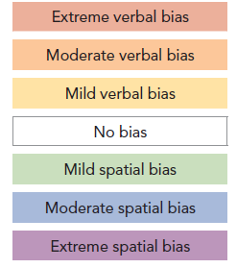
Lesson 2: CAT4 Feedback
The CAT4
Student Profile
Indicates a students bias/potential towards learning
verbally (with words) or spatially (with shapes/spaces).
Less and less people
Majority of people have no bias towards either thinking skill
Less and less people

Slide 17
Lesson 2: CAT4 Feedback
The CAT4
Using the Student Profile making Subjects Choices
Consider the word based before
the technical and graphical subjects
All subjects will suit
Consider the technical and graphical
subjects before the word based subjects

Slide 18
Lesson 2: CAT4 Feedback
The CAT4
Fast forward 6 Years.....
Profile
College Course
Arts Commerce Communications
Media Law Health Sciences Journalism
Arts Commerce Health Sciences
Engineering
Lab Science Design Architecture
Engineering IT Financial Mathematics

Slide 19
Lesson 2: CAT4 Feedback
Your CAT4 Results Report

Slide 20
Lesson 2: CAT4 Feedback
Last April, all incoming 1st Year Students were assessed using the CAT4 Cognitive Abilities Test.
The CAT4 tests the students in 4 key areas associated with Words (Verbal Reasoning), Numbers (Quantitative Reasoning),
Shapes (Non-verbal Reasoning) and Shapes and Spaces (Spatial Reasoning).
Each test is scored and a Mean SAS (Standardised Age Score) is calculated from the 4 scores for each student.
The Mean SAS is considered to be the fairest way to compare the performance of different students within a year group.
An average score would be 100.
The CAT4 also considers the scores of the ‘Verbal Reasoning’ and ‘Spatial Reasoning’ tests and uses these to allocate
each student to one of 7 broad ‘profiles’ which can indicate the student’s preference towards the ‘reading, writing and
debating’ or the ‘technical, practical and doing’ type subjects.
Overleaf you will find the CAT4 results for the named student with an analysis of their scores.
Students are advised to consider these scores as part of their overall Subject Choice decision making process in January 2019.
This information should guide students towards choosing subjects based on their abilities with words, numbers, shapes and spaces.
Put simply, these scores are an indication of the student’s potential ability with subjects based on reading, writing and communicating
compared to subjects of a more technical, practical and ‘doing’ nature.
The group average score for each of the 4 test areas are given in the table to ensure that all scores are considered in context.
If you would like further information about the CAT4 please email guidancepca@gmail.com

Slide 21
Lesson 2: CAT4 Feedback
My CAT4 Scores
Form:
Surname: Someone
First Name: O’Someone
Assessment | Score | Average 1st Year Group Score
Mean SAS | 98 | 105.9
Verbal Reasoning - Words | 78 | 107.8
Quantitative Reasoning - Numbers | 100 | 106.7
Non-Verbal Reasoning Shapes | 99 | 102.2
Spatial Reasoning – Shapes and Spaces | 114 | 106.2
Extreme spatial bias
You are strongly more suited to the technical/practical subjects than the wordy subjects.
You should excel in problem solving and will grasp concepts quickly and naturally. You probably do not enjoy
rote learning and may arrive at a correct solution to a task without demonstrating the steps along the way.
Be careful with this as you may lose marks in some subjects for not showing your working out.
You are likely to be a high achiever in subjects that require good visual-spatial skills such as Maths and Physics as well as
Technology. You appear to have a relative weakness in verbal skills so what you understand when being taught may be
uneven and you may need support in subjects where the emphasis is on the written word.

Slide 22
Reflect and Share
The CAT4 results and analysis can give me an indication
of my potential ________ with particular subjects.
I know I use these results to help me to decide on
subjects for my Junior Cycle.

Slide 23
1st Year Careers Guidance
2017 2018
Lesson 1 My Career Interests
Lesson 2 CAT4 Feedback
Lesson 3 Junior Cycle Subject Choices in PCA

Slide 24
Lesson 3
Junior Cycle Subject Choices in PCA
names and number of subjects to choose
what to think about when choosing subjects

Slide 25
Date Careers Mr. Courtney
Lesson 3: Junior Cycle Subject Choices in PCA

Slide 26
9 Subjects for Junior Cycle
In 2nd and 3rd Year students will be assessed as part of the
Junior Cycle in 8 Subjects.
Irish /
Learning Support
English
3 Core
And 5 more….
Maths

Slide 27
Choosing a Modern Language
The first subject a student must chooses is a Modern Language.
French
German
Modern Language
Learning Support
Why?

Slide 28
Choosing a Modern Language
Certain colleges require a Modern Language as a
Leaving Cert Subject for entry to certain courses.
NUIG
UCD
UCC
NUIM
St. Angelas
Shannon
NCAD
RCSI

Slide 29
Choosing a Modern Language
Certain colleges DO NOT require a Modern Language as a
Leaving Cert Subject for entry to certain courses.
UL
GMIT
AIT
LIT

Slide 30
Choosing a Modern Language
These courses in these colleges include but are not limited to:
Arts
Commerce
Law
Medicine
Speech and Language
Veterinary Medicine
Biotechnology
And many more...

Slide 31
Choosing a Modern Language
Courses that DO NOT require a Modern Language
Financial Maths &
Economics*
Nursing
General Science
Engineering
Biomedical Science
* Or a lab science subject

Slide 32
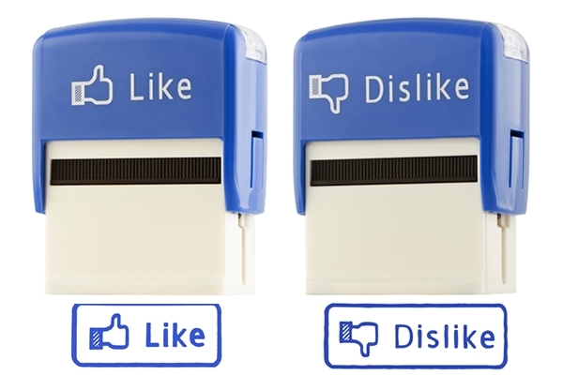
Choosing the remaining 4 subjects
What subjects do I like?
What subjects am I good at?
What subjects might I need in the future?
What does my CAT4 learning Profile suggest?
Do I enjoy the practical or the discussion type subjects?
What are my interests?

Slide 33
What subjects are available?
Communicative Creative Technical
Geography
Science
Music
History
Technical Graphics
Home
Economics
Business
Materials Technology Wood
Visual Art
Technology
Yellow subjects unfold into 3/4 separate Leaving Cert Subjects
Orange subjects change name for Leaving Cert
White subjects available as Leaving cert Subjects

Slide 34
Subjects that unfold?
Junior Cycle
Senior Cycle
Business
Business
Accounting
Subject Course Areas
develop into individual
subjects
Economics

Slide 35
Subjects that unfold?
Junior Cycle
Senior Cycle
Physics
Chemistry
Science
Biology
Subject Course Areas
develop into individual
subjects
Agricultural Science

Slide 36
Subjects that unfold?
A student may need 1 or 2 of these lab science subjects
for entry onto STEM based college courses.
Science
Engineering
Medicine
Dentistry
Veterinary
Pharmacy
Physiotherapy
Radiography
Nursing
Physics
Occupational Therapy
Speech Therapy
Medical Lab. Science
Dietetics
Optometry
Chemistry
Biology
Agricultural Science

Slide 37
History and Geography
Suitable subjects for students wishing to pursue a
Bachelor of Arts Degree in the future. The most popular
Course for Leaving cert Students to study.
Students in University pick 3.
Legal Studies
History
Sociology and Politics
Economics
Geography
Archaeology
Maths
A Language
English
Philosophy.

Slide 38
Subjects that change names?
Junior Cycle
Senior Cycle
Visual Art
Art
DCG
Design and Communication Graphics
Technical Graphics
Materials Technology Wood
Construction

Slide 39
Where can I get more information?
Does it get more difficult?
Is there more/less practical work?
How is this subject assessed?
Your Subject
Teacher
Siblings, family and friends
online
www.ncca.ie

Slide 40
Summary
Your will be choosing a Modern Language and 4 subjects
to study for your Junior Cycle.
Your choices include:
Science
Business
Music
Materials Technology Wood
Visual Art
Technology
Technical Graphics
Home Economics

Slide 41
Reflect and Share
The Modern Language I might choose will be
____________
The 4 Subjects I would consider are:
____________
____________
____________
____________

